Slide 1

OCR - H446 – A Level - Computer Science

Slide 2
Starter:
General discussion on Programming project ideas.
What is the Agile Methodology process of Software Development?
Agile Methodology:
These methods are designed to cope with changing requirements through producing the software in an iterative manner; that is to say, it is produced in versions, each building on the previous and each increasing the requirements it meets.
This means that if on seeing a version the user realises they haven't fully considered a requirement, they can have it added in a future iteration.

Slide 3
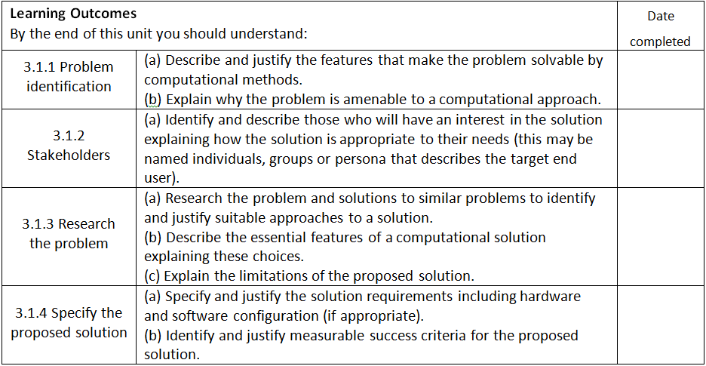
3.1. Analysis of the problem (10 marks):

Slide 4
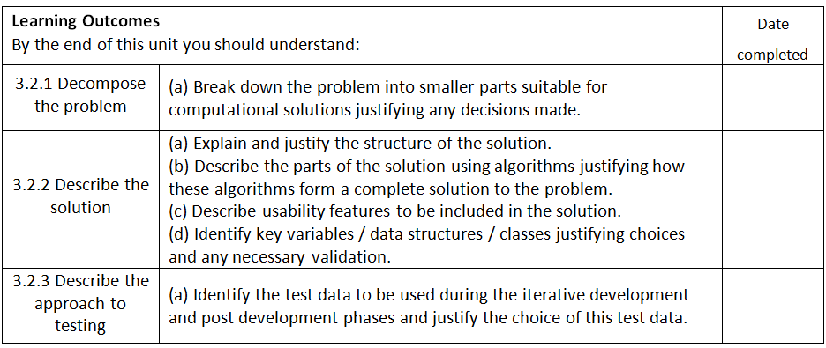
3.2 Design of the solution (15 marks):

Slide 5
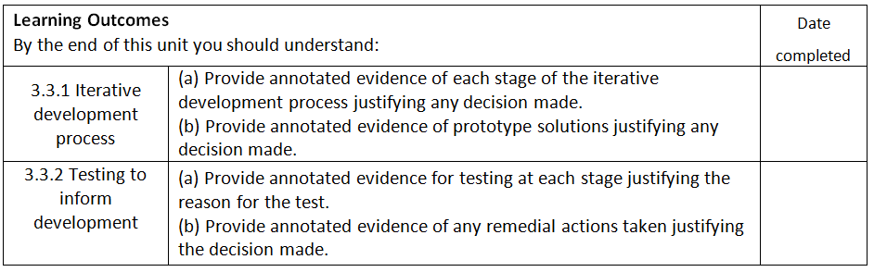
3.3 Developing the solution (25 marks):

Slide 6
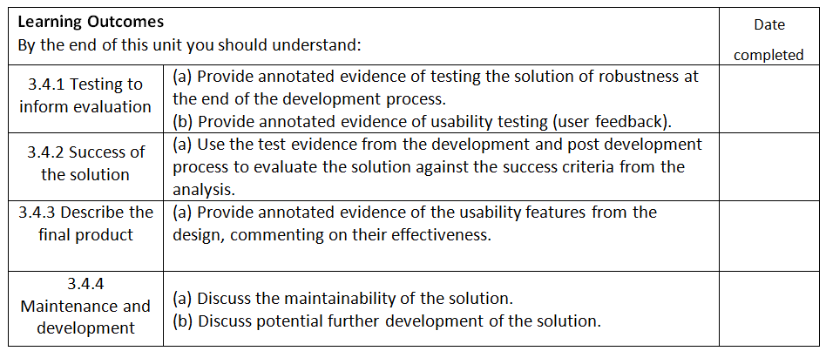
3.4 Evaluation (20 marks):

Slide 7
Acceptable programming languages for the Programming project:
The language chosen for the Programming project should be appropriate to the task chosen. If the task demands another choice of language that does not appear in the list below, the task outline, the details of the programming language and the reasons for the choice of this language should be submitted to OCR for consideration computerscience@ocr.org.uk. All tasks completed in all languages need to have a suitable graphical interface.
Programming languages which OCR will accept:
Python
C family of languages (for example C# C+ etc.)
Java
Visual Basic
PHP
Delphi

Slide 8
Evidence Generation:
Your whole write-up should be in one Word document and not Publisher or PowerPoint.
Cover Page
Title
Contents list
Description of investigation
Justification of investigation
Analysis, design and methods used
Evaluation
Bibliography
Pages numbered
Work submitted for moderation or marking must be page numbered and marked on every page with the: centre number (55119), centre name (Bournemouth School), candidate number, candidate name, Specification title, (Computer Science H446) and Unit title (Programming Project 03).

Slide 9
Assessing Evidence:
High Band: an answer that convincingly meets nearly all of the requirements of a band descriptor should be placed at or near the top of that band. Where the learner’s work convincingly meets the statement, the highest mark should be awarded.
Middle Band: an answer that meets many of the requirements of the band descriptor should be placed in the middle of the band. Where the learner’s work adequately meets the statement, the most appropriate mark in the middle range should be awarded.
Low Band: if an answer is on the border-line between two bands but it is decided that it fits better the descriptors for the lower of these two bands, then it should be placed near the top of that band. Where the learner’s work just meets the statement, the lowest mark should be awarded.

Slide 10
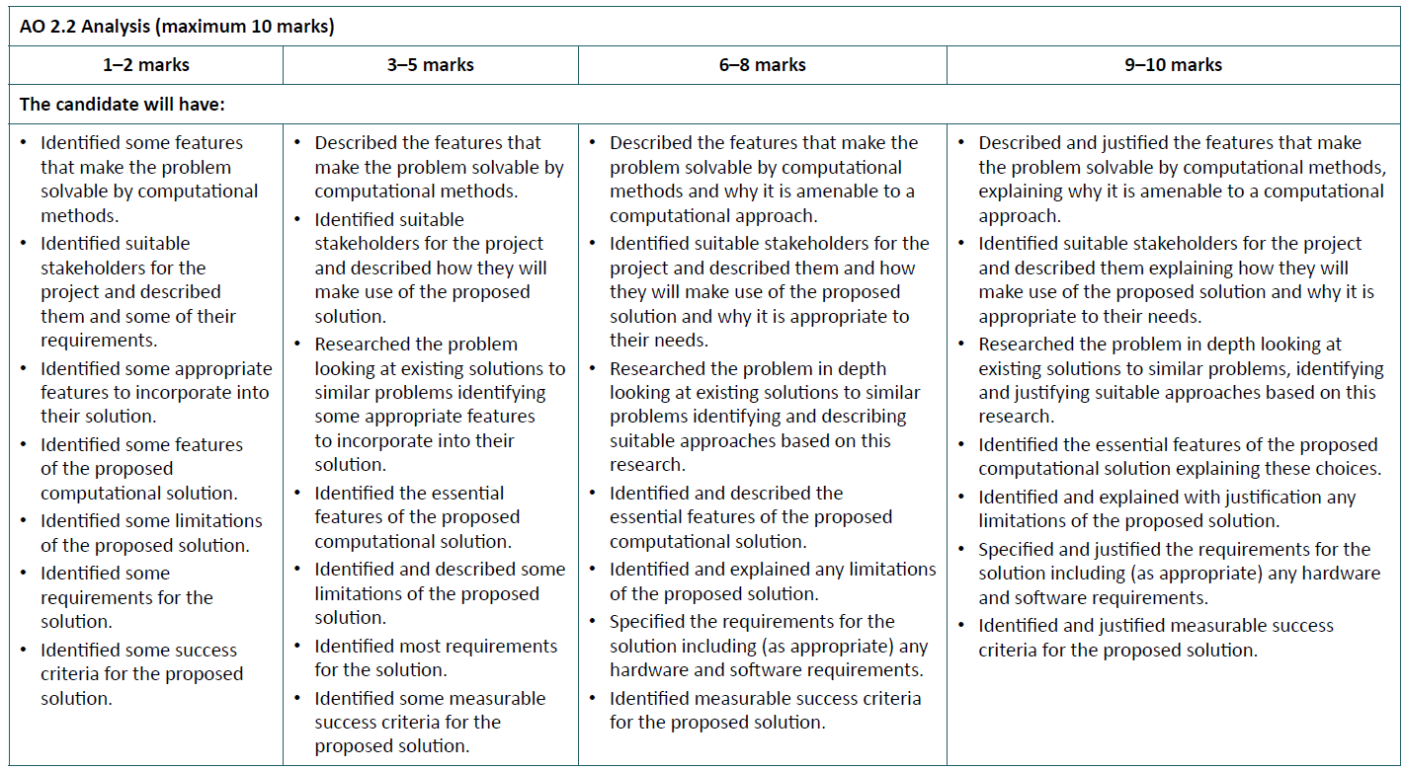
Assessment Criteria:

Slide 11
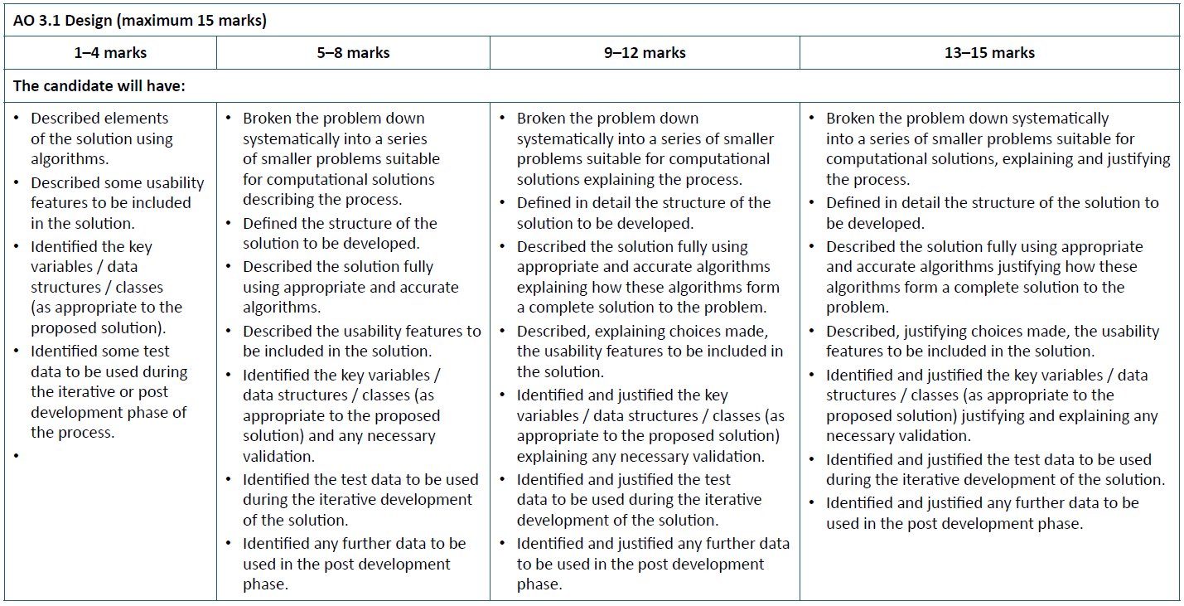
Assessment Criteria:

Slide 12
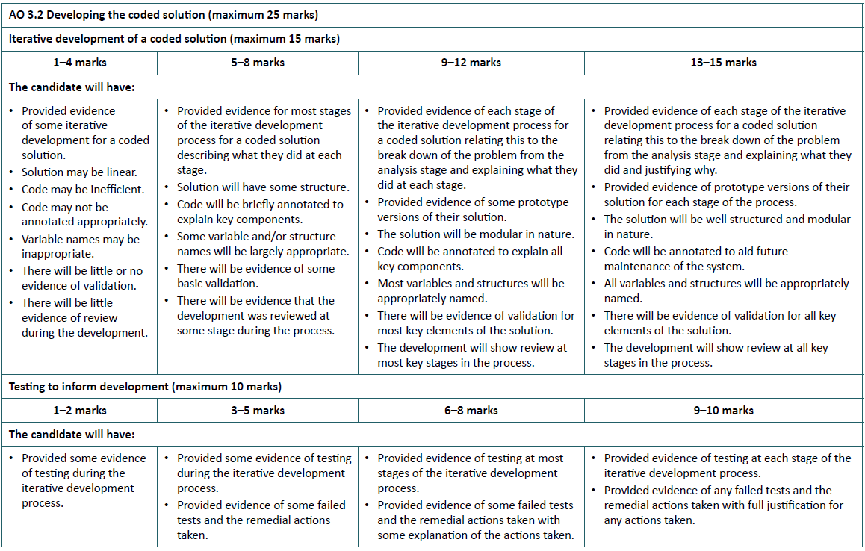
Assessment Criteria:

Slide 13
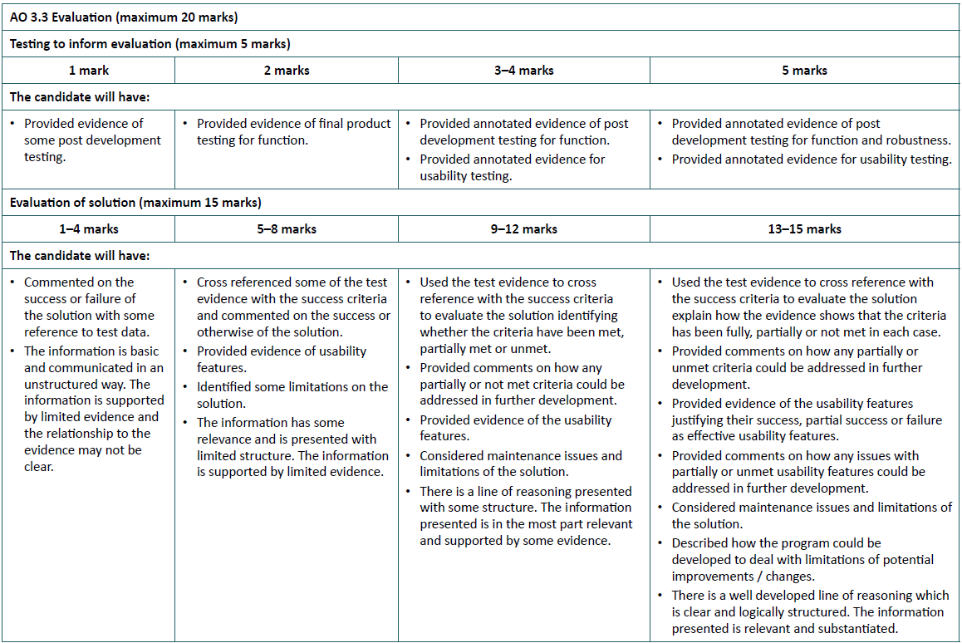
Assessment Criteria:

Slide 14
Advice on complexity in projects:
Depending on the requirements of the project some of the features below will be more relevant than others. These aren’t meant as a tick list but as guidance to some of the features a sufficiently complex project will have.
For example, a project may involve complex algorithms and make good use of external libraries but only have a few settings that need storing in a simple text file.
The important test of whether a project has the required complexity will be if there is enough depth for a candidate to make meaningful decisions about its development and to build it through meaningful iterations.

Slide 15
Advice on complexity in projects:
Storing Data: Most programs will need some form of persistent storage. This may be as simple as storing user preferences or may be as complex as storing large amounts of data to be analysed and generate reports. Candidates will be expected to choose suitable methods of storing this data. In some cases a simple text file or CSV is sufficient in others it may be appropriate to use such storage methodologies such as JSON, XML or even a relational database. These latter options can be indicative of a more complex project.
Use of Libraries: Libraries allow candidates to add functionality to their projects that they may not have the time or expertise to code themselves. Candidates should not worry that they will be penalised for the use of libraries, on the contrary, use of libraries to tackle parts of their problem is best practice. Sensible choice and use of libraries can be an indicator of a good level of complexity in a project. Candidates should be reminded to clearly reference where libraries are used.

Slide 16
Advice on complexity in projects:
Programming Style: There is no set paradigm for the project. The majority of candidates are likely to choose a procedural approach but others are equally acceptable. Some projects may be suited to object-oriented, functional, logical or even assembly programming. Whilst by no means a requirement a candidate choosing a particular paradigm is a good indication that the project has a good level of complexity. Where the project has scope for the candidate to demonstrate commonly used techniques in their chosen methodology this too is an indication of a good level of complexity. For example, a candidate programming in an object-oriented language may structure their program using a model-view-controller pattern, a candidate creating a web-based project may use AJAX for improved responsiveness.

Slide 17
Advice on complexity in projects:
Algorithms and Data structures: There isn’t an expectation for candidates to reinvent the wheel. If a program requires sorting of a data structure then a candidate deserves no less credit for using a language’s built in sort routine (as a professional programmer likely would) than if they code their own quick sort algorithm. Similarly if a required data structure is offered by a language a candidate would be well advised to use them rather than recreating them. This said there will be the need for algorithms that aren’t available natively. These might be established algorithms such as Dijkstra’s Shortest Path or MinMax which the candidate needs to implement or an algorithm the candidate has had to devise for themselves. Likewise, existing data structures may need to be adapted to best suit the project. A candidate needing to put clear thought into developing their data structures and algorithms and using them alongside or integrating them with pre-existing data structures and algorithms is indicative of sufficient complexity.

Slide 18
Advice on complexity in projects:
Other: There are many other indicators that can show complexity. These include:
The need to write code to interact with a specific hardware device.
Writing code so devices can share data across a LAN/the Internet.
Combining different technologies in order to produce the final product.
Candidates may need guidance at the very early stage of their project as to whether it has enough scope to be complex and if not how its complexity can be added.

Slide 19
Choice of project:
The choice of project is important. It Will take Several months Of hard work to complete the work and this is much easier when there is an interest in the topic chosen for the project. Acquiring new programming skills in another language can be time consuming so it makes sense to select a project that Can be completed using existing skills or existing skills that can be developed relatively easily.
The project must be coded, so avoid those that are based on using applications or that rely on the use of a drag and drop environment - these lack the necessary features to meet many of the criteria. When considering a project carefully read through the assessment criteria to check that these can be met. There is no degree of difficulty criterion - the project assessment guidance takes care of this - and there are many clues to what is necessary in the descriptors for example a simple linear program will fail to meet the criteria for modularity and there must be a clearly defined target audience: the stakeholders.

Slide 20
Choice of project:
When choosing a project make sure you have access to suitable stakeholders who can advise on the requirements.
These can be representative of a persona, for example a chemistry simulation aimed at A Level chemistry students can be discussed with a teacher and fellow students taking A Level chemistry. An educational game aimed at primary-school students can be discussed with a primary school teacher or teacher with experience of the topic area and piloted and tested by younger students. These stakeholders will be invaluable during the analysis, design, development, testing and evaluation of the product.
While the computer game may seem immediately attractive, writing games involves a lot of repetitive coding and may not be the most exciting option. It is worth looking into scenarios such as simulations, models, visualisations and other novel areas for a project topic. Look far and wide for interesting and novel scenarios.

Slide 21
Analysis of the problem:
Proper analysis of a problem is often overlooked by candidates eager to start coding their solutions, but careful analysis of a problem is the key to success when programming.
A programmed solution to a problem is an abstraction of reality - obvious for those who choose to create simulations for chemistry or physics or biology, but true for the vast majority of project types.
Devising an abstract model of the situation is the first stage in a successful project. You will need to identify a suitable problem and identify the features that make it amenable to a computational solution.
Programs are written to be used by someone - the stakeholder – and you need to identify who will use the program, explaining clearly what their needs are, why they will find the solution useful and why the solution is appropriate to their needs. Stakeholders may include people other than end users, for example a web-based project will need to consider the needs of the website owner, any staff employed by the website owner and the website users. Each of these has a stake in the product and each has different requirements for the product. All of these must be considered.

Slide 22
Analysis of the problem:
These stakeholders may be real people who you can talk to about their needs and requirements, or it may be a persona who typifies the target group. A persona is a profile for a typical user, which is used throughout the design and development stages to make sure the end-user needs are considered at each stage of the process. It is important to identify the intended end users and their needs and requirements before moving on to the next stage.
Some detailed research will be required to identify what is possible. It is essential you look at existing solutions to similar problems that may provide valuable insights into aspects of the problem and potential solutions. It is important the stakeholder is considered for this research. It would be of limited value to research programs aimed at adult users when considering educational games for primary-age children, as their needs, skills and requirements are significantly different.

Slide 23

Analysis of the problem:

Slide 24
Analysis of the problem:
Research into existing solutions to similar problems will provide information that can be used to justify an approach to the problem and identify suitable features to be incorporated into the solution.
This process may also identify any limitations on the solution being proposed, for example to the scope of the solution. For example a program to draw mathematical transformations may be limited to a specific range of transformations or objects. You will need to explain and justify these limitations to the proposed solution.
Once the analysis of the research is completed, it is possible to specify the proposed solution and justified requirements, including any software or hardware requirements and the choice of programming language.
The requirements for the solution provide the basis for identifying a set of measurable criteria that can be used to evaluate the effectiveness of the final product. These success criteria must relate to the requirements and the needs of the stakeholder, but should be measurable; that is, you can prove that they have been achieved through suitable test procedures.

Slide 25
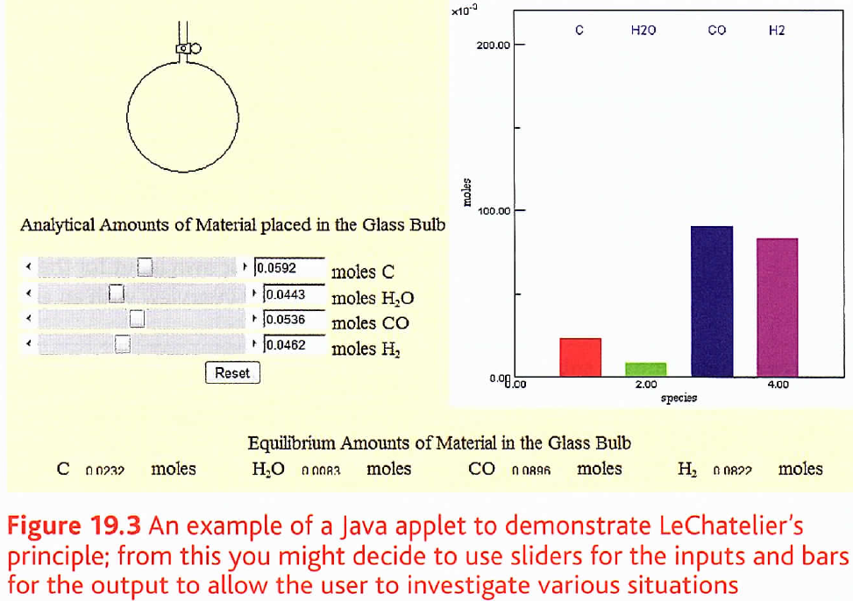
Analysis of the problem:

Slide 26
3.1. Analysis of the problem (10 marks):

Slide 27
Assessment Criteria:
Supply all of the evidence requested on the next few slides and title your sections using keywords from the Mark Scheme above

Slide 28
Evidence:
Justify why the problem can be solved by computational methods:
Do explain why the problem is suited to a computer program.
Do explain the features of the problem that are amenable to a programmed solution.
Do explain why the output from the solution is valuable to the stakeholder.
For a stock control program, this will include better management of stock, bringing potential savings on overstock or out-of-date stock.
For a science simulation, it could be because it reinforces learning of certain concepts or simulates features that are difficult to create in a laboratory.
For computer games or utilities explain the interest from the Stakeholders in the game or the need for the utility.
Don't simply state that you are going to create a program because it is needed. You must justify your decisions.
Talk to your stakeholders and get some User Requirements.

Slide 29
Evidence:
Research:
Do provide detailed research into existing solutions to similar problems.
Do show that the research identifies features that can be adapted for use in the proposed solution.
Do show how the research provides insight into the proposed solution and how the features to be used are appropriate.
Don't rely on your own input for the solution to a problem.
Don't rely on an interview with an end user for all of your research into the problem.
If there is a current system used by the stakeholders which is computerised or not you must describe it in detail.

Slide 30
Evidence:
Features of the proposed solution:
Do identify, list and explain the features of the proposed solution.
Do identify any limitations on the proposed solution.
Some problems may be too large to complete in the time allowed.
It may be appropriate to identify desirable features that will not be included in the solution (these can be revisited in the evaluation).
Do be realistic about what can be achieved in the time allowed.
Don't attempt to solve problems that are too complex to complete in the time allowed.

Slide 31
Evidence:
Software and hardware requirements:
Do specify any hardware requirements for your solution.
If there are only limited requirements, specify the minimum hardware required to implement the solution.
Do specify any software requirements for your solution.
If any additional software is required or if the solution only works with specific versions of software, identify this.
Do identify any additional utilities that will be required to implement the solution.
Don't list all the software available simply to justify a choice.
Don't simply identify what software you are using.

Slide 32
Evidence:
Success criteria:
Success criteria should link the stakeholder requirements to a test plan and will be used with evidence of testing to evaluate the final product.
Do specify the success criteria for the proposed solution.
These must be measureable criteria based on the stakeholder requirements.
Do specify success criteria that can be demonstrated through testing.
Don't specify vague subjective criteria, such as a colourful interface or easy or quick to use.

Slide 33
Design:
The problem identified will include some complexity and it will not be possible to code it as a simple linear program. It is important the problem be broken down into its component parts before attempting to create a design for a solution.
Systematically decompose the problem until it is a series of solvable sub-problems suitable for a computational solution. Typically this will be a set of identified procedures needed to complete the solution.
These procedures will need to be completed in a specific order to solve the problem and this provides the detailed structure for the solution to be developed. These procedures and how they are linked must be fully described using suitable algorithms.
The algorithms must be able to describe the solution in detail, showing how the program will solve each of the individual sub-problems and how these sub-problems are combined into a single solution for the whole problem.
The algorithms should be detailed enough to hand on to another programmer to complete the project.

Slide 34
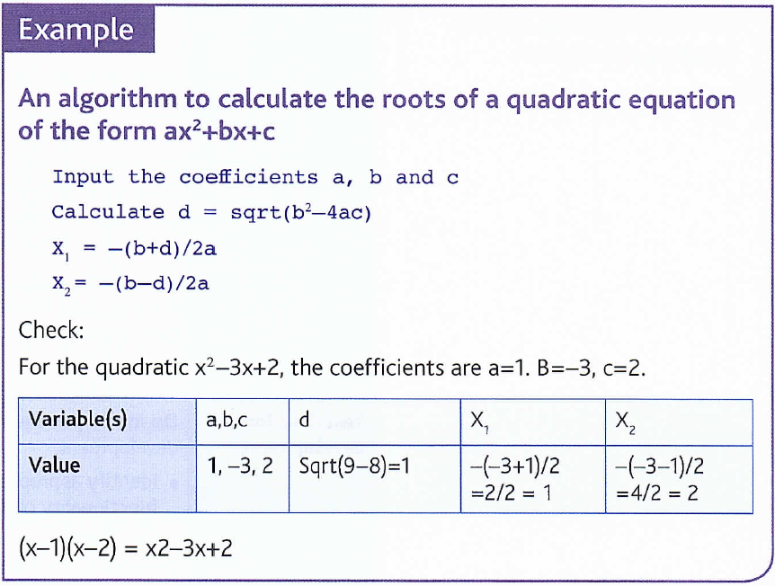
Example:

Slide 35
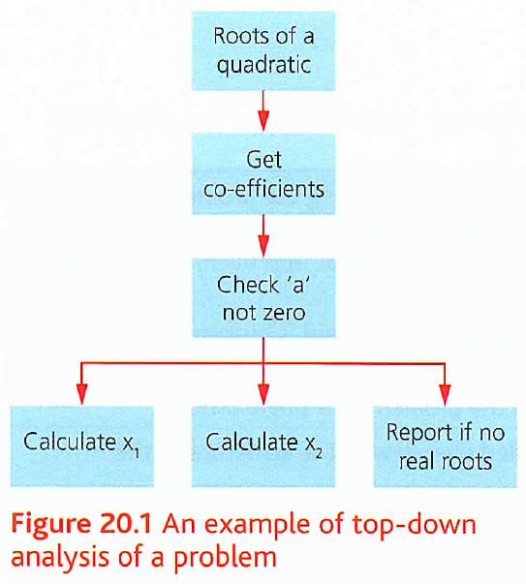
Example:

Slide 36
Design:
Programs create output from inputs by processing the data.
Use the requirements for the program to identify the necessary outputs and consequently derive the necessary inputs and processing.
Justifying the choices made and providing an outline demonstration of how these algorithms define a solution is important.
Input and output is the means of communication with the end user of a program.
These usability features should be chosen carefully and the choices justified in terms of the stakeholder requirements. For a simulation, for example, the user will need to set starting conditions. Will these be typed or selected from a list or set using an on-screen dial or slider? The decision will be the result of choices made for the user interface for the program.
The solution will be processing data and it is vitally important to select appropriate data types, suitable data structures, necessary validation and variable names that identify their purpose. These data items will need suitable test data to be used during the development process to ensure the processing produces the desired results and the validation rejects unacceptable values.

Slide 37
Example:
Including solutions to a quadratic equation
For a program that includes the solutions to a quadratic equation some decisions need to be made:
Are non-integer coefficients allowed?
Are we interested in non-real roots?
Will we accept a=0; that is, a simple linear equation?
If we are only accepting coefficients that are integers, some validation on the input values is required and this needs to be checked with real values to make sure they are rejected.
For real roots only a check that b2>=4ac is required and values such as 1,2, 4 should return an error message such as ‘this equation has no real roots’.
Lf we want to ignore linear equations then a=0 must be validated and rejected.

Slide 38
3.2 Design of the solution (15 marks):

Slide 39
Assessment Criteria:
Supply all of the evidence requested on the next few slides and title your sections using keywords from the Mark Scheme above

Slide 40
Evidence:
Decompose the problem:
Do provide evidence of decomposing the problem into smaller problems suitable for computational solution.
Do provide evidence of a systematic approach, explaining and Justifying each Step in the Process.
A table showing how each problem is broken down or a description of the process will be suitable.
You need to break it down into functional areas which should each be a single subroutine or function in your final solution describing Modular Programming or Top Down Design.
Don't simply state the problem as a single process.
Structure of the solution:
Do provide a detailed overview of the structure of the solution as a Modular Structure Diagram of the solution or Class Diagrams.

Slide 41
Evidence:
Algorithms:
Do provide a set of algorithms to describe each of the sub-problems.
Do show how these algorithms fit together to form a complete solution to the problem.
Do show how the algorithms have been tested to show that they work as required for example with Dry Runs and Trace Tables.
Don't simply provide an outline data flow.
Don’t provide code or reverse engineered code as an algorithm.
Usability features:
Do describe with justification the usability features of the proposed solution.
Do explain and justify the design of any user interface or interface with another system.
Don't spend ages creating colourful drawings of the user interface.

Slide 42
Evidence:
Key variables and structures:
Do identify and justify the key variables.
Do explain and justify the data Structures that are to be used in the solution.
Do describe and justify any validation required.
Test data for development:
Do identify and justify any test data to be used during development.
Identify appropriate data that can be shown to test the functionality of the program for development testing Purposes.
Don't create a full test plan for this stage; this is data to be used at each stage of the development process.

Slide 43
Evidence:
Test data for beta testing:
Do identify and justify test data to be used post-development to ensure the system meets the success criteria.
Do identify data that is designed to test the robustness of the solution; good testing attempts to break the program.
Don't create a test plan for this at this stage; the data will be used in a final test plan for the product at the post development testing stage.
This is a more full and extensive list of test data than that used in development testing and is for Beta testing.
Show Normal, Extreme and Erroneous data.

Slide 44
Development:
Developing a computer program is an iterative process. Each procedure should be developed and tested then modified as necessary before moving on to the next one using an agile development process to create your solution.
In real life this process would be completed in consultation with the client and stakeholders. The design should have included a description of the procedures and the order in which they should be developed. Follow this process through, providing evidence of the testing at each stage.
However, as with all development exercises, results of testing may provide insights or highlight problems with the original plan. It is perfectly acceptable to modify this plan during development, as informed by the testing.
The development should be a narrative on the process showing each stage of the development, the testing carried out with results, any modifications to that section or procedure and any modifications to the overall plan.

Slide 45
Development:
Code should be modular in nature, with each section of the code explained and suitably annotated to explain its purpose. To aid future maintenance of the code, it is important this annotation is clear and the variables are suitably named to indicate their purpose, with suitable validation to ensure the program works under all foreseeable circumstances.
Sensible and meaningful variable names are just one way to make a program maintainable. It is important the code is presented with full annotation, in modular form and with detailed annotation to ensure it can be maintained by another programmer.

Slide 46
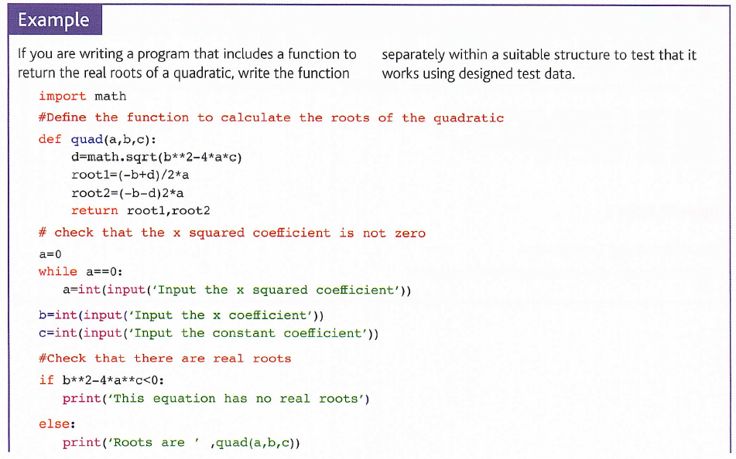
Example:

Slide 47
Example:
This segment of code includes the routine necessary to check for real roots and the function and that the x squared coefficient a is non-zero.
These key points are identified using suitable annotation. ln this case, the variables a, b, a and d are those used in mathematics and appropriately named.
The variables used to return the values of the root could be called x1 and x2 but it is clearer here to use root1 and root2.
This code segment should be tested with the data from the design section, including testing for a=0 and situations with no real roots, as well as with data that returns a known result.

Slide 48
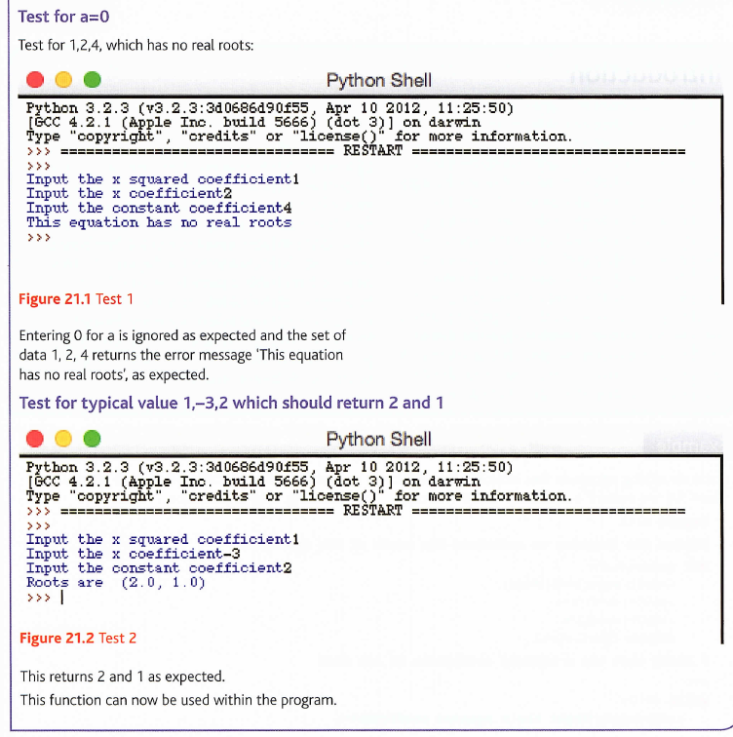
Example:

Slide 49
3.3 Developing the solution (25 marks):

Slide 50
Assessment Criteria:
Supply all of the evidence requested on the next few slides and title your sections using keywords from the Mark Scheme above

Slide 51
Evidence:
Iterative development:
Do provide evidence of iterative development showing how the complete program was developed stage by stage.
Do provide evidence showing how each section of the program was coded and tested.
Don't simply supply completed code for the program as evidence.

Slide 52
Evidence:
Prototyping:
Do provide prototype versions of the program at each stage of the process that show the annotated and explained code.
Do provide evidence of testing at each stage using the test data identified in the design section.
Annotated modular code:
Do annotate the code at each stage of the process.
Do use meaningful names for all variables, structures and modules.
Do provide code in a modular form; simple linear code is unlikely to be sufficient for this unit.
Do provide the code as separate modules.
Don't simply supply the complete code for the program as evidence; the code must be developed in suitable stages.

Slide 53
Evidence:
Validation:
Do supply evidence of validation.
Do supply evidence that the validation has been tested and works as expected.
Do supply evidence that all testing covers a wide range of valid and invalid inputs and situations.
Reviews:
Do review each stage of the process in the development phase, summarising what has been done and how it was tested.
Do explain any changes required and any modifications to the design of the solution that result from the testing.

Slide 54
Evaluation:
Once the development is complete, the program needs to be tested against the original success criteria using typical and atypical data.
The program needs to be tested to ensure it fulfils the brief and that it is robust. Test using typical data, including extreme values to ensure the product works as expected and meets the success criteria established as part of the design.
Use atypical data to ensure the program does not fall over easily. Good testing will attempt to break the program and conditions that cause the program to fail should be explored and reported, along with any suggestions for remedial action that might be taken, or even reported with the remedial action that has been taken.
It is quite possible for the plans to have changed during development and these changes should be commented upon and any unmet criteria acknowledged and explained.
Future maintenance of a program is an important issue and the evaluation should consider the limitations of the solution and potential developments, and indicate how these might be addressed.

Slide 55
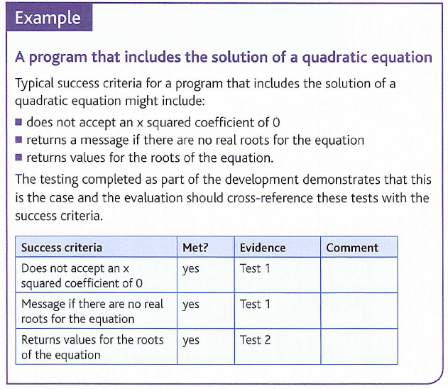
Example:

Slide 56
3.4 Evaluation (20 marks):

Slide 57
Assessment Criteria:
Supply all of the evidence requested on the next few slides and title your sections using keywords from the Mark Scheme above

Slide 58
Evidence:
Testing:
Do provide evidence of testing on the completed solution.
Do provide evidence that the system functions as designed.
Do provide evidence that the system is robust and will not fall over easily.
Show that you have tried to break the program.
Do cross-reference the test evidence against the success criteria from the analysis section to evaluate how well the solution meets these criteria.
Usability features:
Do show how the usability features have been tested to make sure they meet the stakeholders, needs.

Slide 59
Evidence:
Evaluation:
Do comment on how well the solution matches the requirements.
Do comment on any changes that were made to the design during the development stage.
Do comment on any unmet criteria or features and comment on how these might be achieved in future development.
Do comment on any additional features that might be useful and how these might be approached.
Don't comment on the development process and anything you learned or how much you enjoyed it.
Maintenance:
Do discuss future maintenance of the program and any limitations in the current version.
Do discuss how the program might be modified to meet any additional requirements or changing requirements.
Do comment on the maintenance features included in the program and report.

